Slide 1
The Risks and Benefits of Social Media, and its Place in Higher Education.
COMP 360 - DD252935

Slide 2
Intro
This research & development project looks at the utility that social media platforms can provide in a university setting as a means to justify, design and develop an institutional social media site to aid in the academic and social aspects of university life.
Notes:
This research & development project looks at the utility that social media platforms can provide in a university setting as a means to justify, design and develop an institutional social media site to aid in the academic and social aspects of university life.

Slide 3
(intro) Research Problem/Justification
Coming to university can be daunting, especially if you don’t manage to find your social circle straight away.
Not finding any social channels can leave students feeling alone & isolated.
Moodle/Learning space offers some forum functionality but is not very engaging or enticing.
The social tools need attention.
Notes:
Coming to university can be very scary, as students are not only potentially moving to a new area, but have to find a new social circle.
{{CLICK}}
Being unable to find any social channels (if any are actually in place) can leave students feeling alone and isolated. Lockdowns and isolations during the pandemic left many students segregated and created an environment in which many had left home to find themselves unable to socialise and find their new student cohort.
A discord server exists, but can only be found if you come across an invite.
{{CLICK}}
There is some Forum functionality on the existing student portal, but this inst particularly engaging or enticing to use.
{{CLICK}}
As such, there is a need for better
online socialization tools to be adopted by universities.
{{CLICK}}

Slide 4
(intro) Research Problem/Justification
Could an institutionalised social media platform benefit the academic and social aspects of university life?
Notes:
The research question I was looking to answer is:
Could an institutionalised social media platform benefit the academic and social aspects of university life?
{{CLICK}}

Slide 5
(related work) intro
The review of past literature is split into two sections.
Social media in Higher education
What benefits could be gained, and could it be used to enhance or add an additional level to the quality of education provided?
The effects of social media
What risk would be involved with such an implementation?
Notes:
To answer this responsibly I needed to research into..
Past works around using social media in higher education
{{CLICK}}
To find out what benefits could go be gained and how could a social media platform benefit the university experience?
{{CLICK}}
And the effects of social media
To understand what risks would be involved with implementing such a thing?

Slide 6
(related work) Social media in Higher education
Social media in higher education.
Presented positive outcomes when implementing social media platforms into university courses.
Each platform is a tool in a toolkit.
Was seen to boost team work ethic.
Was seen to increase course engagement.
Ability to reach others around the world.
Ease of collaboration
Can be a source of distraction if not done correctly.
Notes:
Positive outcomes were noticed when implementing social media platforms into university courses.
{{CLICK}}
Liu talks of each social media platform being a tool, each in its own specific right and each with its designated purpose, for example Facebook's ubiquity and capabilities for collaboration
{{CLICK}}
Kelm [4] also implemented social media into their course and reported a greater sense of team ethic between classmates.
{{CLICK}}
and noticed an increase in course engagement.
{{CLICK}}
Two main consensus’s were observed within the literature review, the first being that social media platforms made it easier to reach others around the world,
{{CLICK}}
making collaboration between individuals easier and more accessible.
{{CLICK}}
With the second being that if not done responsibly, with a lack of understanding or without balance, could add a source for distraction.

Slide 7
(related work) The effects of social media
Effects of social media
Papers noted a need for a better understanding of social media.
Can be an environment where bullying and discrimination can take place.
Social media sites can host many factors for distraction.
Social media addiction.
Social anxieties and depression.
Platforms can be used for illegal activities.
Notes:
{{CLICK}}
All studies seemed to agree that there is a need for a greater understanding of the risks of social media to be able to fully leverage its many benefits.
{{CLICK}}
Social media sites, if left unmonitored can be the prime environment for negative and unwanted behaviour such as discrimination and bullying.
{{CLICK}}
There are also the less directly harmful aspects to consider, such as excessive amounts of advertisements that cause distraction and promote time-wasting and other non-productive activities.
{{CLICK}}
It is engaging in these activities and succumbing to the lure of these advertisements that gives social media its addictive nature...
{{CLICK}}
Which left unchecked, can lead to conditions such as low self-esteem, depression and anxiety.
{{CLICK}}
Another point noted in the literature is that platforms can be used for criminal activity, by putting to use the freedoms offered by social media to hide their identity and engage in things like cyberbullying, cyber terrorism, human trafficking and drug dealing.
{{CLICK}}

Slide 8
(related work) some critiques
All studies observed opted to use existing platforms, which could both help and hinder the studies.
Many participating in the study may already be on the platform.
Participants may have been previously using the platform for other means (social & time passing)
Factors for distraction are in place.
Features are well built and developed by large companies over time.
Features and services are reliable and well known.
Notes:
{{CLICK}}
Using platforms that already exist could mean that participants would already have account, mitigating frustrations around having to sign up to something new.
{{CLICK}}
With that in mind participants would already be familiar with the platform, making it easier for students to engage with course tasks.
{{CLICK}}
Already having accounts and potentially a fully populated friends list of users outside of their courses, many factors for distraction are in place. This spans across the friends list, the content on the platform, adverts and so on.
{{CLICK}
Features on the platform are well built systems and developed by large companies so have a solid degree of sophistication.
{{CLICK}}
Features and services are so widely used that they have been subject to large amounts of user testing and as a result are very reliable and well-known.

Slide 9
(related work) what we could do better
A platform built purposely for this research & development project would be free of some of the distraction factors.
No adverts
Platform will be institutional.
With less adverts, distractions and games, and the semi-professional nature of the platform, social media addiction may be less likely to occur.
Module based channels could result in a better ecosystem professionally and mentally.
The platform could provide an educational toolkit.
Notes:
{{CLICK}}
A platform build purposefully for this research & development project would be free of some of the distraction factors
{{CLICK}}
No adverts on the platform would help students stay engaged and reduce distraction factor.
{{CLICK}}
With the only users being fellow students, outside distractions would be minimised.
{{CLICK}}
With less adverts and games along with the semi-professional nature of the platform, social media addiction may be less likely to occur.
{{CLICK}}
A platform with module based channels could result in less lifestyle posting and reduce the factors seen to cause social anxieties and depression.
{{CLICK}}
As existing platforms have been identified to be tools in a toolkit, the prototype platform could include tools to assist students with their education, making time spent on the platform, time spent well.
{{CLICK}}

Slide 10

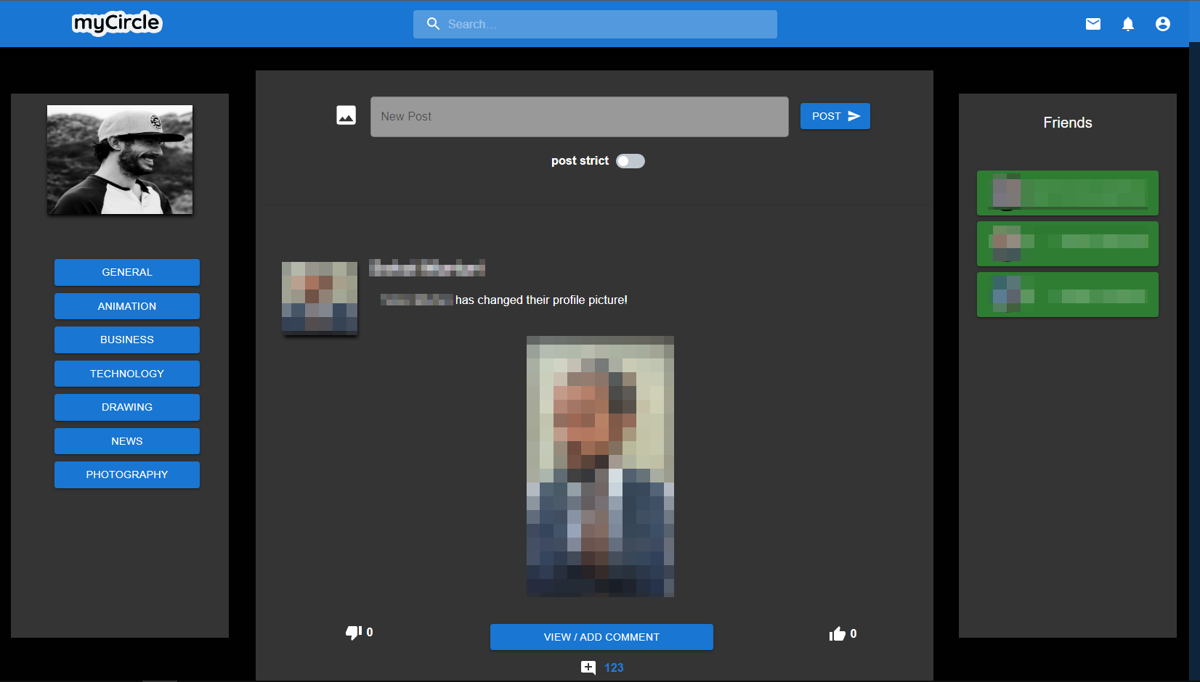
Prototype design (myCircle)
The prototype platform is called “myUniSocial”
Base system adapted from “myCircle”
Circles were changed to modules
Notes:
The title of the platform is “myUniSocial”, the core of which the system is an evolution of my work carried out in developing a previous social media system
{{CLICK}}
The previous system or ‘myCircle’ was built around interests and hobbies as opposed to simple media reposting to navigate the negative impacts observed in the above review of past literature and the comparison culture that exists in modern society. In recognition of the distraction factor mentioned by many in the literature review, it felt like somewhat of a responsibility to minimise possible distractions on the platform, and if they do exist, to make them a benefit to engage with and for it to be relevant to their course.
{{CLICK}}
To achieve this, in place of the interest groups or ‘circles’, course modules are displayed allowing users to quickly access course content and helpful materials.
Image shown can be seen in Appendix E 17 in the handout.
{{CLICK}}

Slide 11
Prototype design (myCircle features)
The platform ‘myCircle’ has most of the functionality you would generally expect from a social media site.
Sign up/ Sign in.
Search for friends.
Add friends.
Share posts.
Interact with posts.
Notifications.
Send messages to other users.
Change profile picture.
Post to friends profiles.
Change profile header picture.
Change account password.
Change profile information.
View different module news feeds.
Post into module news feeds.
Edit followed module news feeds.
Upload images on news feed posts.
Notes:
Sign up/ Sign in.
{{CLICK}}
Search for friends.
{{CLICK}}
Add friends.
{{CLICK}}
Share posts.
{{CLICK}}
Interact with posts.
{{CLICK}}
Notifications.
{{CLICK}}
Send messages to other users.
{{CLICK}}
Change profile picture.
{{CLICK}}
Post to friends profiles.
{{CLICK}}
Change profile header picture.
{{CLICK}}
Change account password.
{{CLICK}}
Change profile information.
{{CLICK}}
View different module news feeds
{{CLICK}}.
Post into module news feeds.
{{CLICK}}
Edit followed module news feeds.
{{CLICK}}
Upload images on news feed posts.

Slide 12

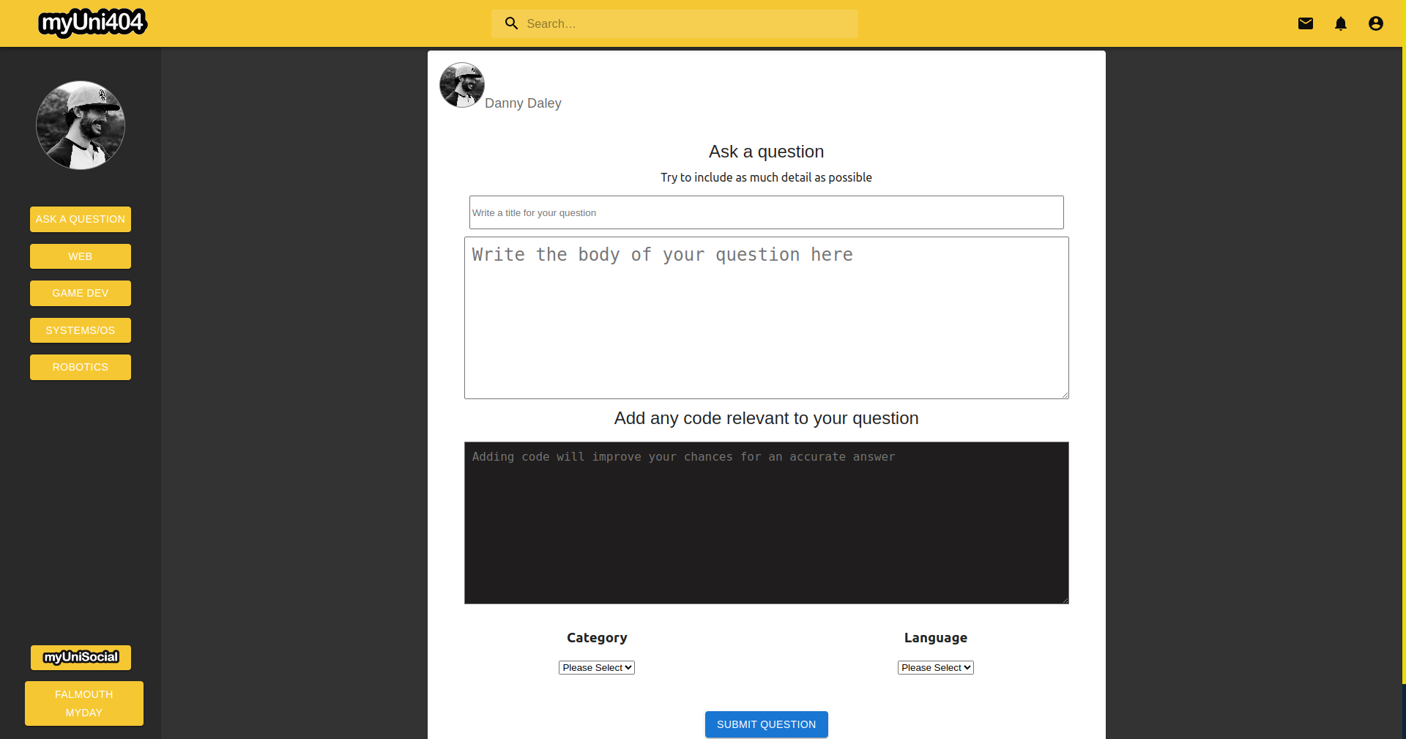
Prototype design (myUni404)
myUni404
A platform to help to help beginner programmers debug & problem solve.
Users can ask and answer questions.
Different fields of computing.
Notes:
Work from my other platform ‘myUni404’ is built in as a feature to aid students in various fields of
Computing,
{{CLICK}}
this platform offers users the ability to post coding, programming and tech related questions which users can in turn reply to answer with code snippets to supplement their
answers, and is browsable by speciality
{{CLICK}}
ie. - Web Development, Game Development, Robotics and so on. ‘myUni404’s built with a beginner-friendly focus and this will be a great step in the direction of making the social network educational while building confidence in expertise.
Image shown can be found at Appendix E figure 19 in the handout.
{{CLICK}}

Slide 13
Prototype design (myUni404 features)
The integration of ‘myUni404’ brings the following functionality
Users can ask coding questions.
Users can add code blocks to questions.
Built in text editor/syntax highlighter
Users can search for questions that may answer their query.
Users can answer questions.
Users can add code to answers.
Text editor accepts different programming & markup languages.
User profiles display previously asked & answered questions.
Users can browse questions by tech field.
Notes:
Users can ask coding questions.
{{CLICK}}
Users can add code blocks to questions.
{{CLICK}}
Built in text editor/syntax highlighter
{{CLICK}}
Users can search for questions that may answer their query.
{{CLICK}}
Users can answer questions.
{{CLICK}}
Users can add code to answers.
{{CLICK}}
Text editor accepts different programming & markup languages.
{{CLICK}}
User profiles display previously asked & answered questions.
{{CLICK}}
Users can browse questions by tech field.

Slide 14

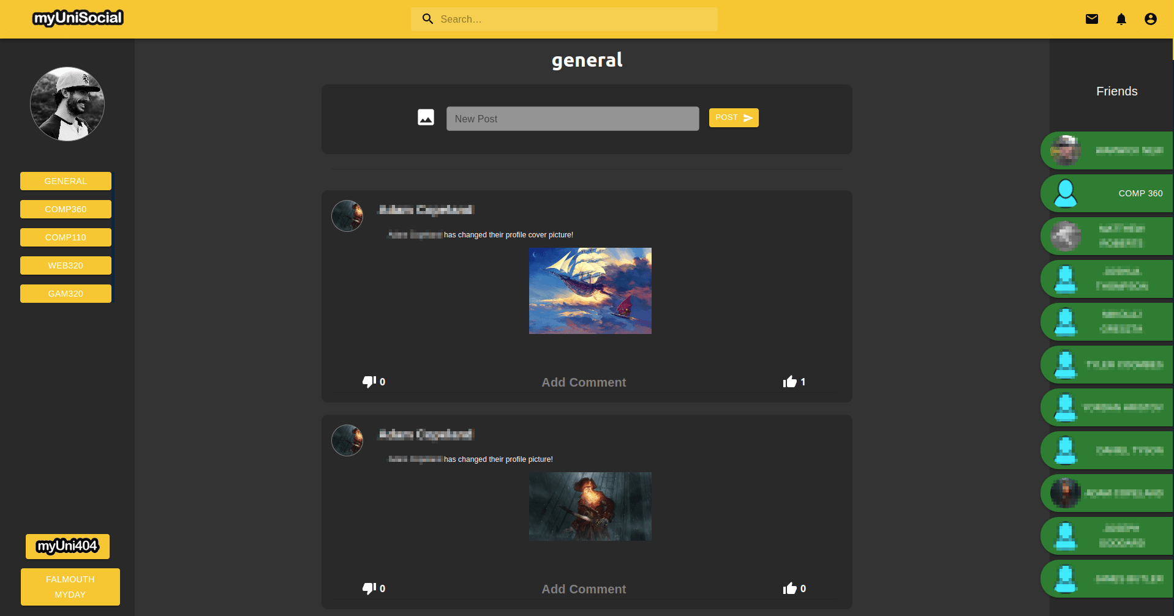
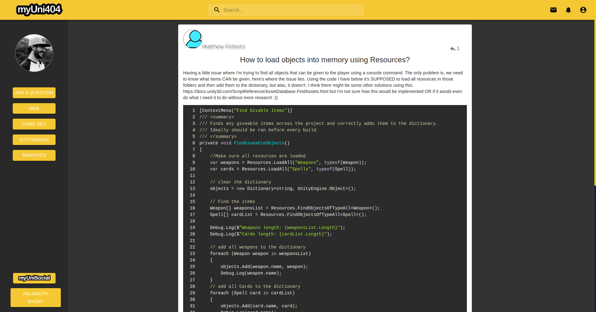
Prototype development (layout)
MyCircle was adapted to myUni404 layout
University colour scheme
Notes:
Elements of the user interface of the platform were designed to have a familiar feeling experience to what users have generally come to expect from social media platforms, with ‘myUni404’ being an improved version of the ‘myCircle’ user interface, the ‘myCircle’ elements were updated to include the improvements to achieve a consistent feel of quality across the platform.
Images shown can be found at Appendix E figures 18 & 20
{{CLICK}}
Colour schemes that somewhat align with the university were used to give users a sense of what the platform could feel like if the platform was backed by the university and was the new standard for a student portal-based platform.

Slide 15
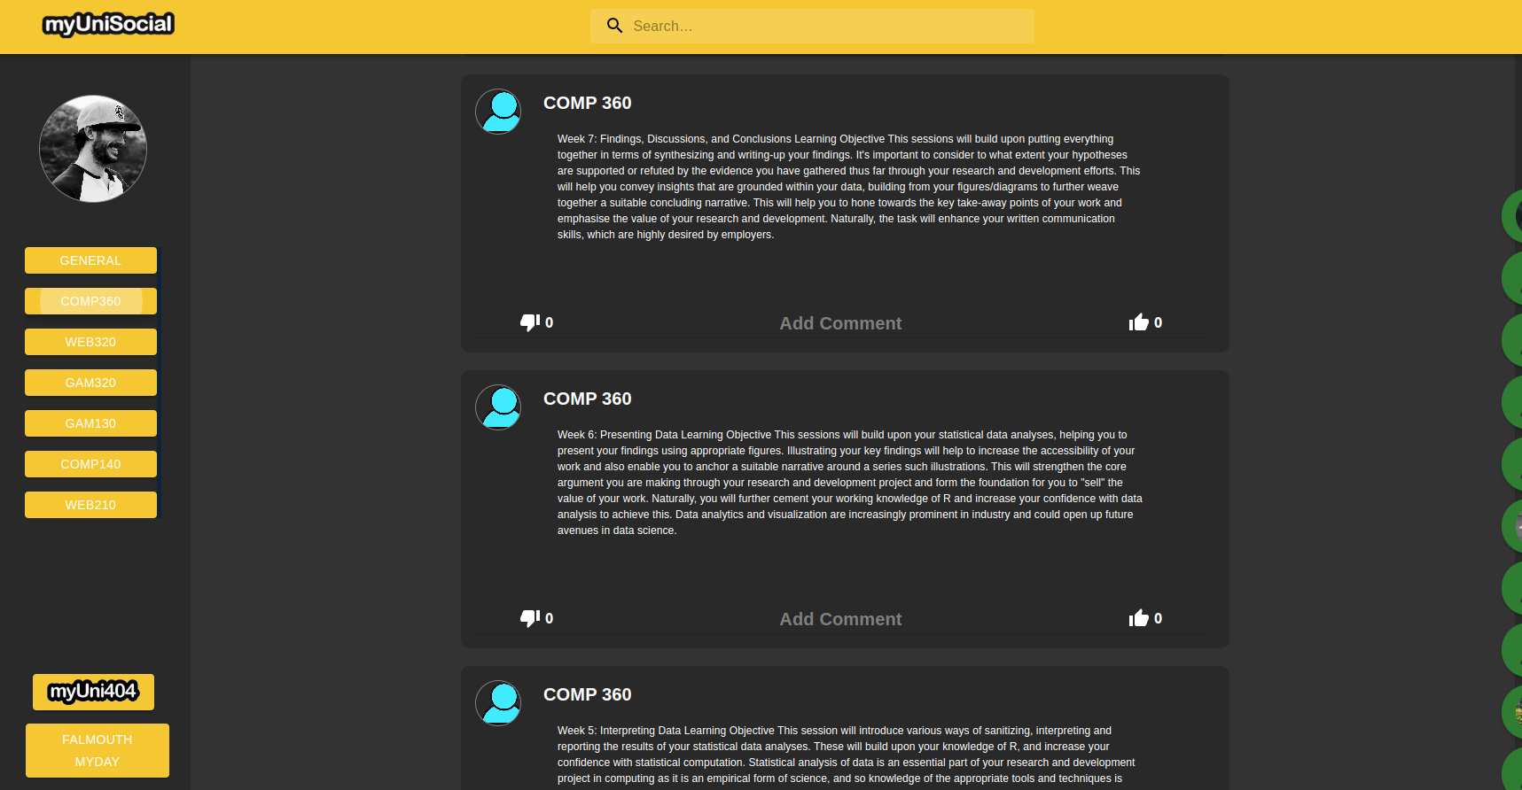
Prototype development
‘Circles’ were replaced by modules.
Modules act as user accounts
Notes:
Circles from the myCircle platform were replaced by modules which users could follow and unfollow to see course updates.
{{CLICK}}
Each module has a user account and profile, which users could go to see all of their module updates in one place, seperate to the feed.

Slide 16
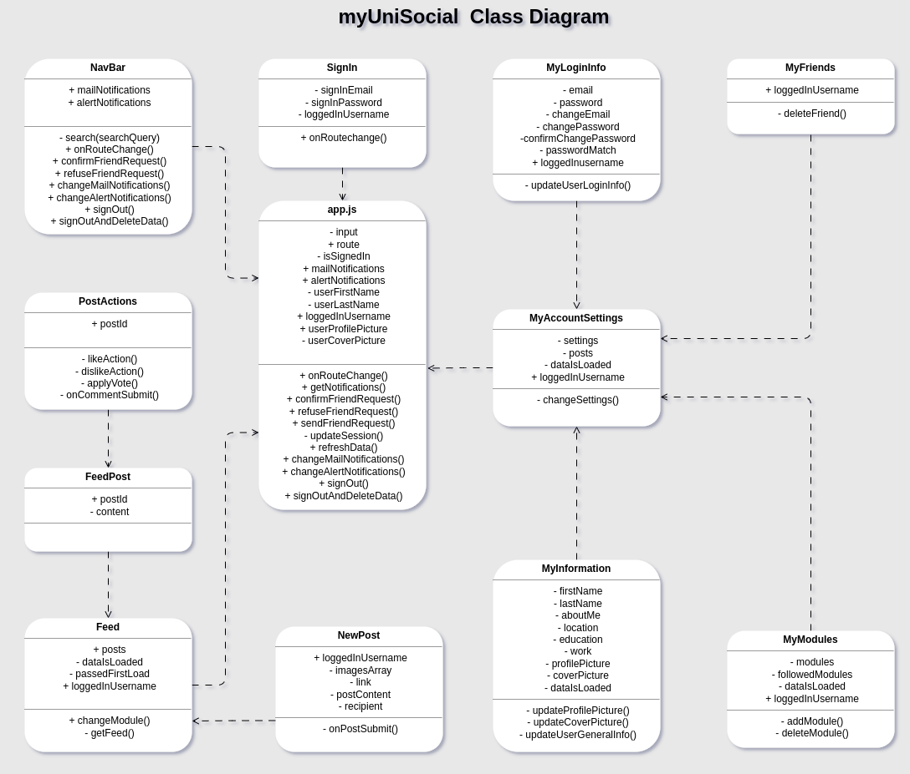
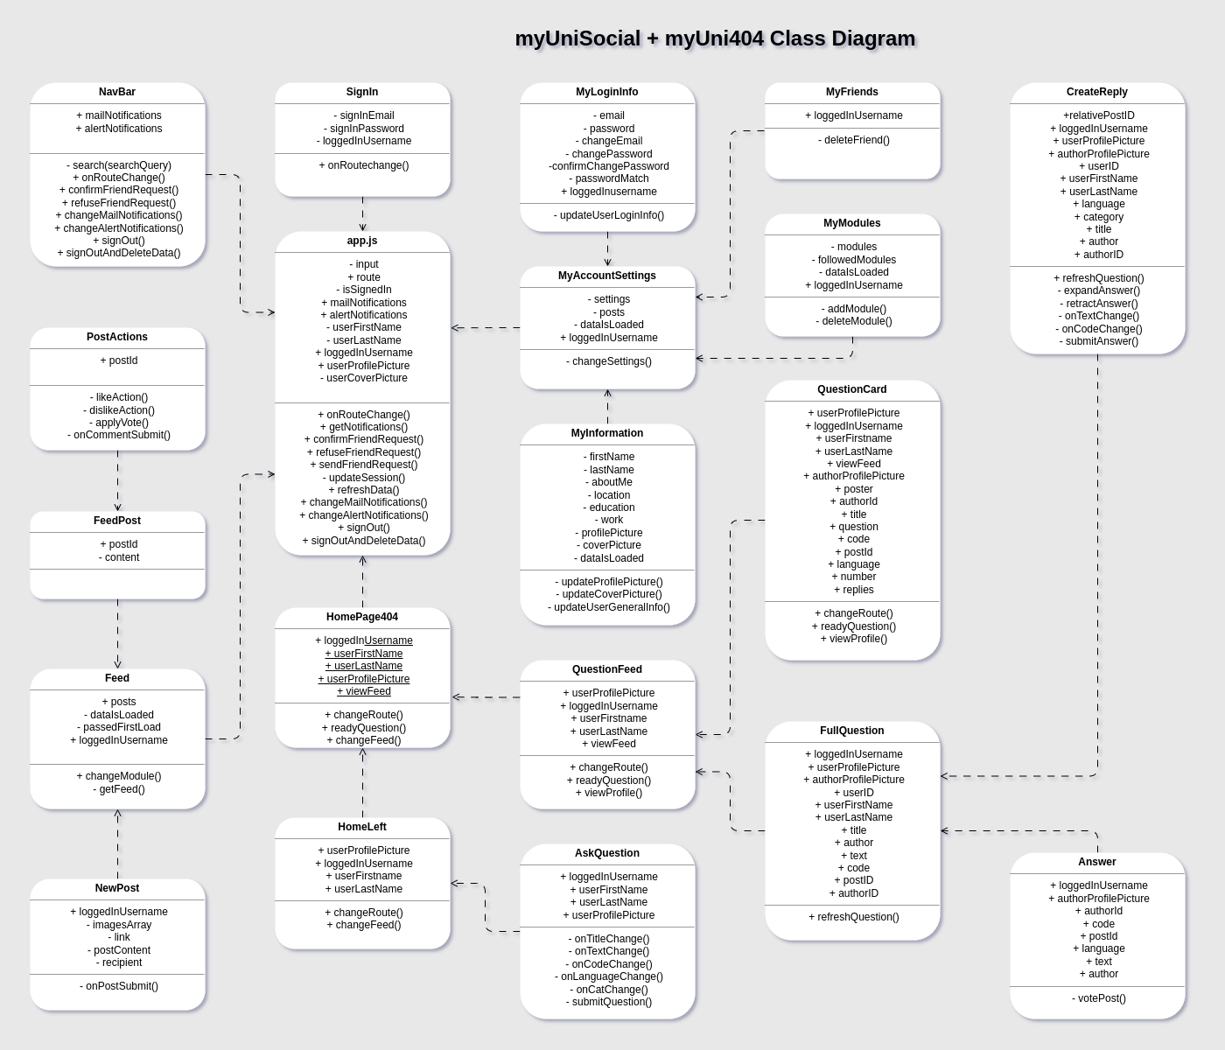
Prototype platform development
Codebase grew considerably from the base system.
But was more manageable following better practices.
Notes:
In appendix D figure 14 a class diagram shows the base system, with the main functionality coming from ’App.js’ and being passed into functional child components. This class
diagram is a derivative of the previously mentioned ’myCircle’ system with the relevant adjustments before the merging of the myUni404 platform, as is the same for the Use Case Diagram which can be seen in Appendix D figure 16.
{{CLICK}}
The growth of the system after introducing the second platform can be observed by comparing Appendix D figure 14 and 15 as shown on screen. With better conventions followed, the codebase was more manageable despite being bigger.

Slide 17
Prototype development (refactor)
Server-side code refactor.
Original server file was around 1200 lines.
New server was modular files of around 200-400 lines.
New maintainability helped with development.
Socket for chat system
Sessions worked better
Notes:
Following better practices meant a big refactor of the original server code.
{{CLICK}}
The original myCircle server code was one file
consisting of around 1200 lines which grew considerably with
the introduction of the code from the second platform. With those better practices and striving to meet and maintain
industry standards...
{{CLICK}}
endpoints were grouped by area of responsibility (ie relating to account settings, fetching or working with feed data etc.) and split into
separate modular files.
{{CLICK}}
This resulted in a massive increase incodebase maintainability and making the project much easier to work with.
{{CLICK}}
The previous version of the chat system relied on the page making a request to the back end and updating regardless of there being any new messages or updates waiting. Granted this system worked but in its nature added an unnecessary load on the server. In its place, the new system utilised web sockets to allow for real-time updates with no extra requests to the server as there is a single pipeline of
communication established between the two users.
{{CLICK}}
Further improvements to the back end of the site refining how browser sessions were implemented. Browser sessions allow the web browser to store small pieces of data about the platform so that the website can remember things like the users’ username, profile picture and whether or not they have an active session, removing their need to log in after every page refresh and in turn improving the overall user experience of the platform.

Slide 18
Stack front-end
ReactJS front-end
Material UI for front-end styling
React Syntax Highlighter for myUni404 functionality
Notes:
The stack used for the platform is a React.js front-end…
{{CLICK}}
making use of Material UI for styling …
{{CLICK}}
and React Syntax highlighter for myUni404 functionality

Slide 19
Stack back-end
NodeJS powered back-end
ExpressJS for server and routing functionality.
MySQL for data storage
Some others noted in the project readme.md
Notes:
The system has a NodeJS powered back-end…
{{CLICK}}
with Express for server functionality.
{{CLICK}}
The project utilises a mySQL database for its capabilities
of working with data relationally.
{{CLICK}}
Other technologies are at play as dependencies such as Axios for front end to back end requests, a full list of technologies can be found on the project github link in Appendix H.

Slide 20
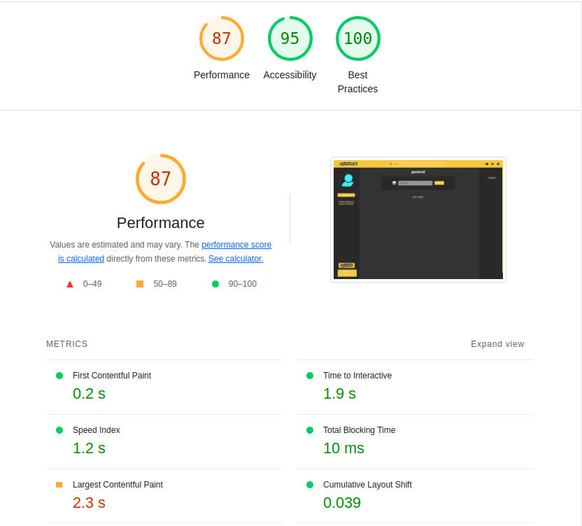
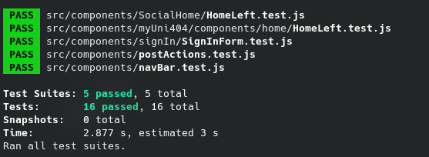
Testing front-end
Most used front-end components were tested
Google LightHouse tested overall
performance of the main feed page
Notes:
Prototype front-end components were subject to unit tests which can be seen in Appendix B figure 8.
{{CLICK}}
The most frequently used and constant of components were tested and all testing suites produced passing outcomes.
{{CLICK}}
Google Lighthouse was used to test overall page performance and accessibility for the feed page, the output of this test can be seen at Appendix B figure 9.

Slide 21
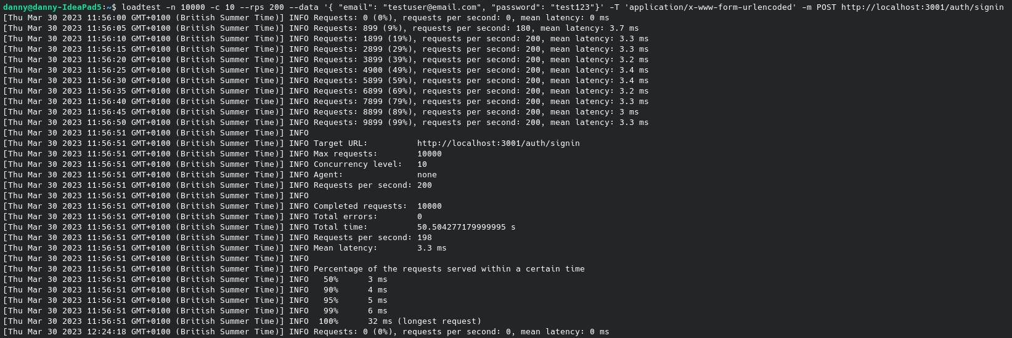
Testing back-end
Login form was stress tested
Local environment
Notes:
The login form was also stress tested with 10,000 requests at a rate of 200 requests per second. Login information for a test user was passed into the test to see how the login form and
database handled the load of such a volume of requests.
{{CLICK}}
Given that hosting solutions were limited and the server played host to important files and other projects, it was not an option at this time to stress test the deployment on the production server, this test was performed on a local deployment. The command could be performed in the same fashion seen in Appendix B figure 10 as seen onscreen, on a staging environment, the figure shown displays the output given for the local instance.

Slide 22
Methodology (Research question & hypotheses)
Research Question
Could an institutionalised social media platform benefit the academic and social aspects of university life?
Hypotheses
Hypothesis: The prototype platform has a positive effect on the social and academic aspects of university life.
Null Hypothesis: The platform has no effect, or a negative effect on the social and academic aspects of university life.
Expected outcomes of the research
I expect users to have a higher satisfaction rate using my prototype platform compared to participants using the system currently in place.
Notes:
To reiterate the question I was looking to explore..
{{CLICK}}
Could an institutionalised social media platform benefit the academic and social aspects of university life?
{{CLICK}}
{{CLICK}}
The hypothesis is that the prototype platform has positive effect on the social and academic aspects of university life.
{{CLICK}}
While the null hypothesis is that the platform has no, or a negative effect of the social and academic aspects of university life.
{{CLICK}}
{{CLICK}}
My expected outcome is that users will have a higher satisfaction rate using my prototype platform compared to participants using the student portal or learning space that is currently in place.

Slide 23
Methodology (Philosophical & experimental design)
Methodology, qualitative/quantitative?
An interpretivist philosophical design.
A mixed methods study with qualitative and quantitative questions.
Notes:
As there is an element of social sciences at play, an interpretivist design was used which called for a qualitative method of data collection and analysis.
{{CLICK}}
Qualitative research is usually commonplace when exploring social sciences, but with qualitative surveys often being subject to criticism for flawed reliability and generalisability, a quantitative survey was also used in an effort to add further reliability to conclusions and make the study more robust, ultimately making this a mixed method study.
{{CLICK}}

Slide 24
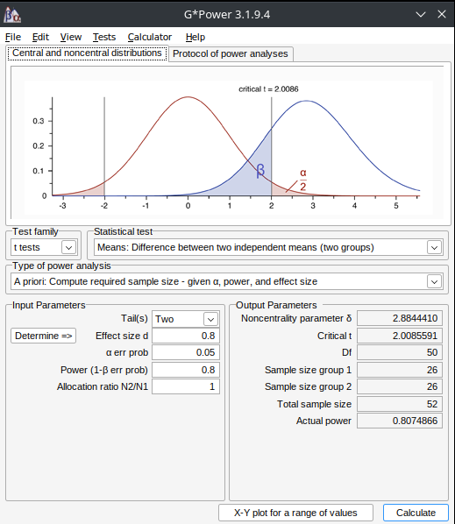
Methodology (Data management)
Data Collection.
Data was collected from a sample of 52 students.
A within groups experimental design was used. Group A performed tasks on the Learning Space/ Student portal, group B performed tasks on the prototype platform.
Participants were surveyed on their experiences of fulfilling some tasks, outlined the survey.
Where was data stored?
All survey data was stored in a Microsoft OneDrive
How was data be kept confidential?
All identifying data was removed prior to storage.
Research data was anonymous.
Sign out & Delete data functionality was built into the platform.
Notes:
For Data collection
{{CLICK}}
Data was collected from a sample of 52 students, this number was calculated using G Power which is a piece of software used for power analysis and calculating an ideal sample size for obtaining meaningful results. This output gives an error probability rate of 0.05%, the inverse of which gives us a confidence level of 95%. We can see the output of Gpower on screen and at Appendix F figure 21.
{{CLICK}}
A within groups design was used, which is similar to A/B testing, but instead of users testing both platforms, one set of users test one platform, while the other set of users tests the other.
{{CLICK}}
Participants were given a set of tasks to complete and were asked to rate their experience of doing so on a Likert Scale, followed by a qualitative question asking to explain a little about their experience of performing the task. In an effort to avoid bias, the tasks that were given could be achieved on both platforms.
{{CLICK}}
All survey data collected was kept in a secure Microsoft one drive account.
{{CLICK}}
How will data be kept confidential?
{{CLICK}}
Before data was moved to the Microsoft OneDrive account, any identifying information was removed from the dataset.
{{CLICK}}
Research data was anonymous and any personal or sensitive data of any kind was collected or measured as part of the study.
{{CLICK}}
Sign out and delete data functionality was build into the prototype platform, allowing users to remove all data from the platform if they wanted to.
{{CLICK}}

Slide 25
Research Method and Methodology
Health and safety considerations.
Participants were advised to follow health and safety precautions.
Notes:
Health and safety considerations.
{{CLICK}}
All participants were advised to follow health and safety precautions connected to the use of computer and office equipment, this advice was given in the consent form that all participants were required to read and sign before commencement of the participation.
{{CLICK}}

Slide 26
Methodology (Academic integrity)
How much time was needed?
Development took around 12 weeks.
What equipment or facilities were needed?
R&D of this project only required resources already available.
R&D was conducted solely by myself.
There were no monetary requirements.

Slide 27
Methodology (ethics)
Research Ethics
The research will involve human participants to test the platform.
Ethics approval was secured for this study.
Did participants require any appropriate training?
No special training was necessary for users to effectively participate in the study.
Users were given instructions on tasks to complete as part of their survey.
Users were advised on best practices involved when using their computer and required desk equipment.
Notes:
Given the nature of this study, human participants were required to take part.
{{CLICK}}
To facilitate this, ethics approval was submitted and granted.
{CLICK}}
Did participants require and training to carry out the tasks?
{{CLICK}}
No training was necessary for participants to take part in this study, the study welcomed users of all abilities to test the usability and function of both platforms.
{{CLICK}}
Users were given instructions on the tasks to complete as part of their survey.
{{CLICK}}
Participants were advised on office and computer best practices within the consent form they were required to complete before commencement of their participation.

Slide 28
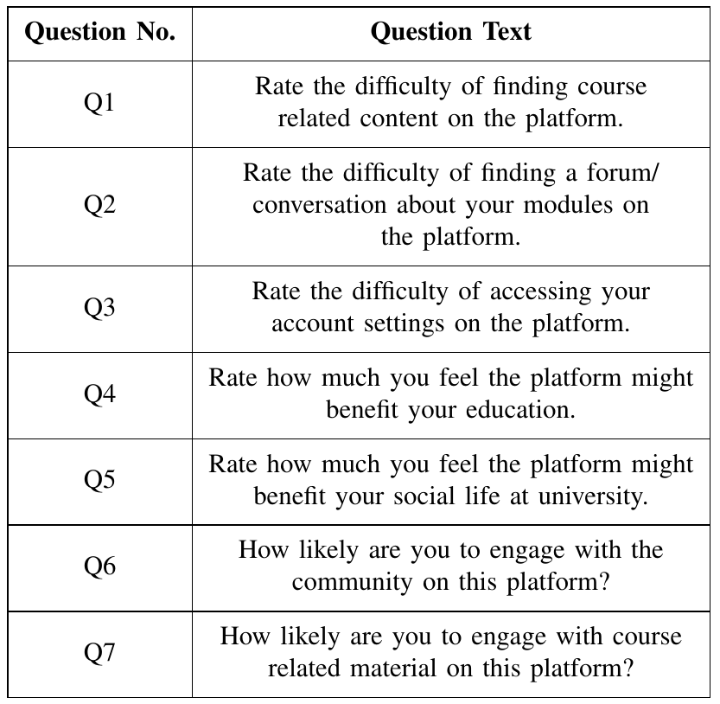
Results (Questions)
The survey consisted of 7 questions.
Each question had two parts.
Rate your experience.
Explain a little about your experience.
Notes:
The survey has 7 main questions, The can be seen on screen or on page 7 of the handout.
{{CLICK}}
Each with 2 parts to complete.
{{CLICK}}
The first was a quantitative question, generally asking users to perform a task such as “find course related content on the platform”
{{CLICK}}
Followed by a qualitative question, asking users to explain a little about their experience of finding course related content on the platform and so on.
The exceptions to task related questions were questions 6 & 7, which asked users how likely they would feel to engage with the community on the platform, and how likely they would be to engage with course related content on the platform.

Slide 29
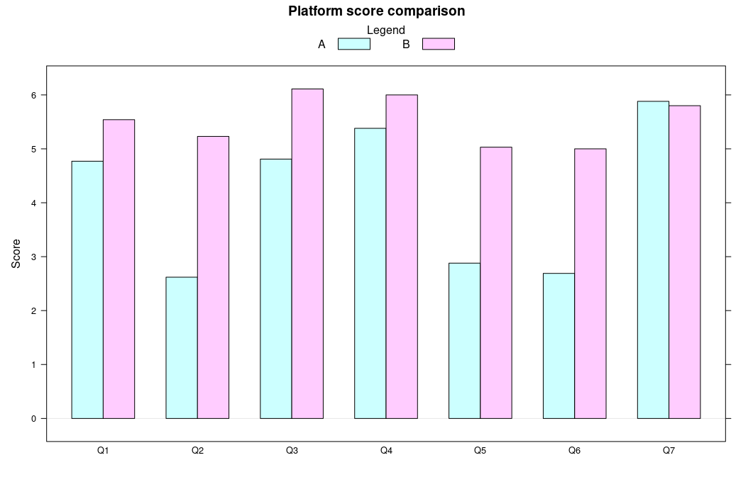
Results (Questions & results)
Users had a higher overall satisfaction rate on the prototype.
Figure shows all quantitative scores for all questions.
Notes:
With the Likert scale ranging from 1 (least favourable
answer) to 7 (most favourable answer) users generally had
a higher overall satisfaction rate on the prototype platform
‘myUniSocial’ with the exception of the final question, “How
likely are you to engage with course-related material on this
platform”, which came in at a very close second.
This Figure (which can also be found on page 7 of the handout) displays the mean scores of all quantitative questions with group A representing the existing student portal and B depicting the scores from the prototype platform.

Slide 30
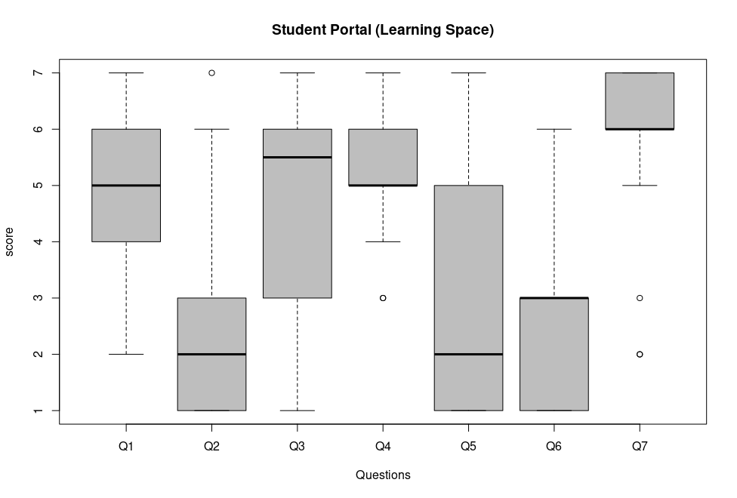
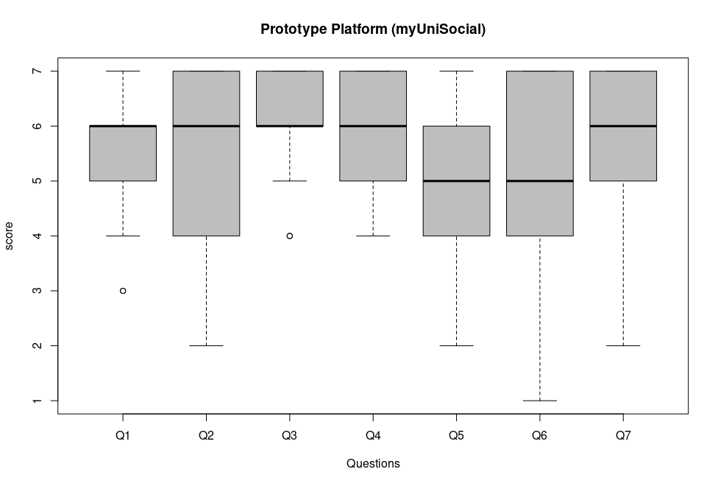
Results (results comparison)
Opinions more spread on student portal
Prototype overall had a tighter and higher satisfaction rate.
Notes:
Opinions were generally more widespread on the student portal
{{CLICK}}
While the prototype platform saw a tighter and more grouped satisfaction rate.
Comparing these boxplots (can be found on page 8 of the handout) shows that there is generally a
widespread within the results, but the majority of the more
favourable results are still claimed by the prototype platform.
This is especially prevalent in any questions related more
toward the social aspects of university, most notably questions
2, 5 and 6.
The student portal scored higher on question 7
which asked users how likely they were to engage with course-
related content on the platform.

Slide 31
Discussion
Data suggested with some significance that an institutional social media platform centred around the university could indeed be of a benefit to both social and academic aspects of university life.
Some participants were unaware of existing functionality on the student portal.
Prototype scored lower due to missing modules/content
Notes:
With the prototype platform generally having a higher overall score across all questions, it is suggested with some significance that an institutional social media platform centred
around the university could indeed be of a benefit to both social and academic aspects of university life.
{{CLICK}}
Participants reported that even having used the existing student portal for some years, they were either unaware of the forum functionality that was in place or that it was simply not enticing to use without it being a criterion for sessioned work. The consensus was that participants saw very little to no benefit to their social lives within the student portal.
{{CLICK}}
Some of the lesser scores for the prototype platform were
generally more centred around finding course-related content
or using the platform as a general aid for their studies as
they would the student portal, and were typically coupled with
qualitative responses explaining that they could not find course content specifically relating to them or their chosen track of study and modules.

Slide 32
Discussion
The prototype received good levels of engagement.
Adds more power to past work.
Users seemed to be able to navigate the platform well.
Users reported not wanting to sign up to something else.
Notes:
The prototype platform witnessed a good level of engage-
ment with some users posting questions into the myUni404
space, changing account profile pictures, posting and generally engaging with other students.
{{CLICK}}
This level of interaction could further support Kelm’s [4] study in which social media was incorporated into course material and noted an increase in course engagement and sense of team ethic.
{{CLICK}}
Participants seemed to have no issues finding their way around the prototype platform or with any aspects of the usability of the system, evidence for this is suggested in the quantitative results as users appear to have experienced more difficulty in navigating certain features of the platform within the student portal than on the prototype social media platform.
{{CLICK}}
Qualitative results from the prototype platform also mention
that having to sign up and register as a user, in contrast
to students already having an account pre-registered on the
student portal at their arrival to university, left participants
feeling that it would be another platform to manage in addition to the social media sites that they regularly use during their everyday lives.

Slide 33
Discussion (improvements)
More robust results would require more permissions/clearance.
Numberless Likert Scale.
Human-computer interaction analytics.
Notes:
For this study to gain more concrete results there would be a requirement for extra clearance and permissions to access university-wide module and student lists or information in order to populate the modules with the correct students, in turn being on equal footing with the student portal and not ultimately comparing a literal against a hypothetical.
{{CLICK}}
making Likert scale range from -4 to 4, or perhaps removing the numbers from the scale entirely in favour of a slider that starts at a neutral position
{{CLICK}}
and implementing some Human Computer Interaction (HCI) analytics software to generate heat maps regarding mouse movements while using the platform to gauge how easily participants were able to navigate the platform.
{{CLICK}}

Slide 34
Discussion (final notes)
A precursor to a promising research area.
If limitations were mitigated..
  Content redistribution (module content)
  Automatic profile generation
  Student/module matching
A definitive answer could be obtained.
Notes:
Given the small window of time to build the artefact and
conduct this study, this research could be regarded as a viable
precursor to a seemingly promising area of research.
{{CLICK}}
With more time, mitigation of limitations such as; having support and access to resources from the institution regarding permissions to
{{CLICK}}
effectively redistribute course content,
{{CLICK}}
student records to facilitate automatic profile and account generation
{{CLICK}}
as well as populating modules on the platform with the correctly enrolled students,
{{CLICK}}
we could definitively answer the research question:
Could an institutional social media platform be of a benefit to
the social and academic aspects of university life.

Slide 35
Future work
If studied further..
Removing unconscious bias.
A tighter and less broad question.
Mitigation of limitations.
Notes:
If this study were to be continued and explored further, adjustments should be made to improve the prospects of acquiring more meaningful results. Modifying the survey Likert as previously mentioned could help remove any unconscious biases.
{{CLICK}}
Making the research question more targeted towards a single and more definitive answer, “benefiting social and academic aspects of university” is perhaps too broad for one study, or this may in fact be grounds for A B style testing to measure those metrics separately.
{{CLICK}}
Limitations and restrictions would need to be mitigated
for this study to continue any further, access to module and
enrolled students or building a system that simply ‘plugs in’
would serve this study well, as students not being able to
find their course or module ultimately hampered my results.
University logos on the platform would help users feel more
immersed in an online university environment and accounts
being pre-registered could in turn pacify users that reported
feeling like it would just be another social media platform to
maintain. Permission to use and essentially redistribute course
materiel, in lieu of a system that ‘plugs in’, would vastly
improve the quality of this study as in doing so would remove
the current need to compare a literal (the university student
portal) with a hypothetical (the prototype platform).

Slide 36
Conclusion
The question remains unanswered..
Evidence suggests the hypothesis stands true
The prototype saw positive levels of engagement.
Overall, a promising study.
Notes:
Acknowledging that this study compared a literal university
student portal with a hypothetical prototype student portal, it
cannot be concluded with certainty that an institutional social
media platform could benefit both social and academic aspects
of university life.
{{CLICK}}
Nonetheless, I feel that given the results,
there is evidence to suggest that if studied further with the previously mentioned limitations and restrictions mitigated that it would be a welcome evolution of systems currently being used and in turn see an increase in student/course engagement while promoting student collaboration.
{{CLICK}}
The prototype platform saw good levels of engagement with users updating their profile information, changing profile and cover pictures, posting and making use of the ‘myUni404’ section of the platform which allows users to post programming or tech-related questions that include a code snippet as well as users also replying to such content.
{{CLICK}}
This behaviour is promising in terms of the
potential for collaboration that such a platform could provide
and seemingly calls for a redesign or reformat of how student
portals function for students at university.

Slide 37


Thanks for listening.
Q&A?

